Slide 1
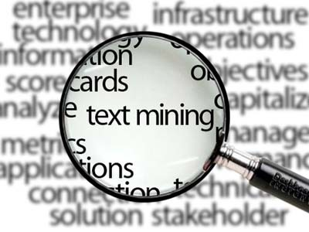
Text Analytics

Slide 2
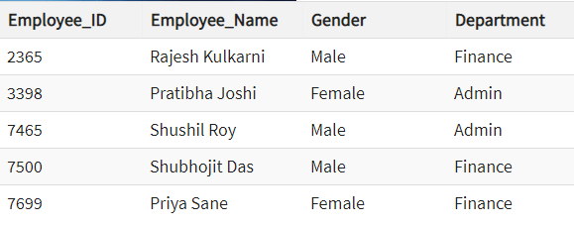
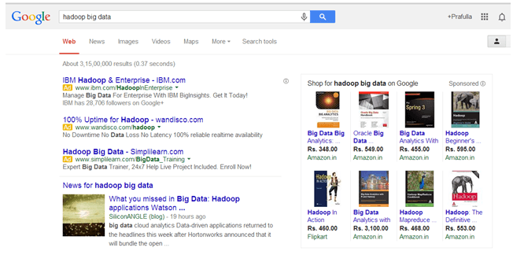
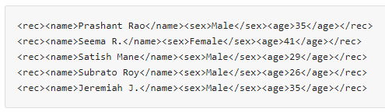
Structured Data
Unstructured Data
An Employee table in a database
Semi-Structured Data
The output returned by Google Search
Personal data stored in an XML file

Slide 3
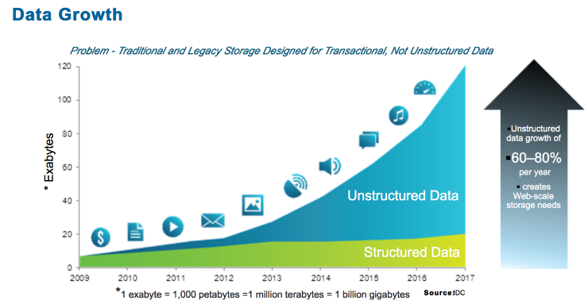
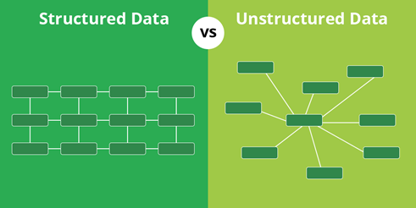

Slide 4
Unstructured Data
Unstructured data has internal structure but is not structured via pre-defined data models or schema. It may be textual or non-textual, and human- or machine-generated. It may also be stored within a non-relational database like NoSQL.
Human-generated unstructured data :
Text files: Word processing, spreadsheets, presentations, email, logs.
Email: Email has some internal structure thanks to its metadata, and we sometimes refer to it as semi-structured. However, its message field is unstructured and traditional analytics tools cannot parse it.
Social Media: Data from Facebook, Twitter, LinkedIn.
Website: YouTube, Instagram, photo sharing sites.
Mobile data: Text messages, locations.
Communications: Chat, IM, phone recordings, collaboration software.
Media: MP3, digital photos, audio and video files.
Business applications: MS Office documents, productivity applications.
Machine-generated unstructured data:
Satellite imagery: Weather data, land forms, military movements.
Scientific data: Oil and gas exploration, space exploration, seismic imagery, atmospheric data.
Digital surveillance: Surveillance photos and video.
Sensor data: Traffic, weather, oceanographic sensors.
https://www.datamation.com/big-data/structured-vs-unstructured-data.html

Slide 5
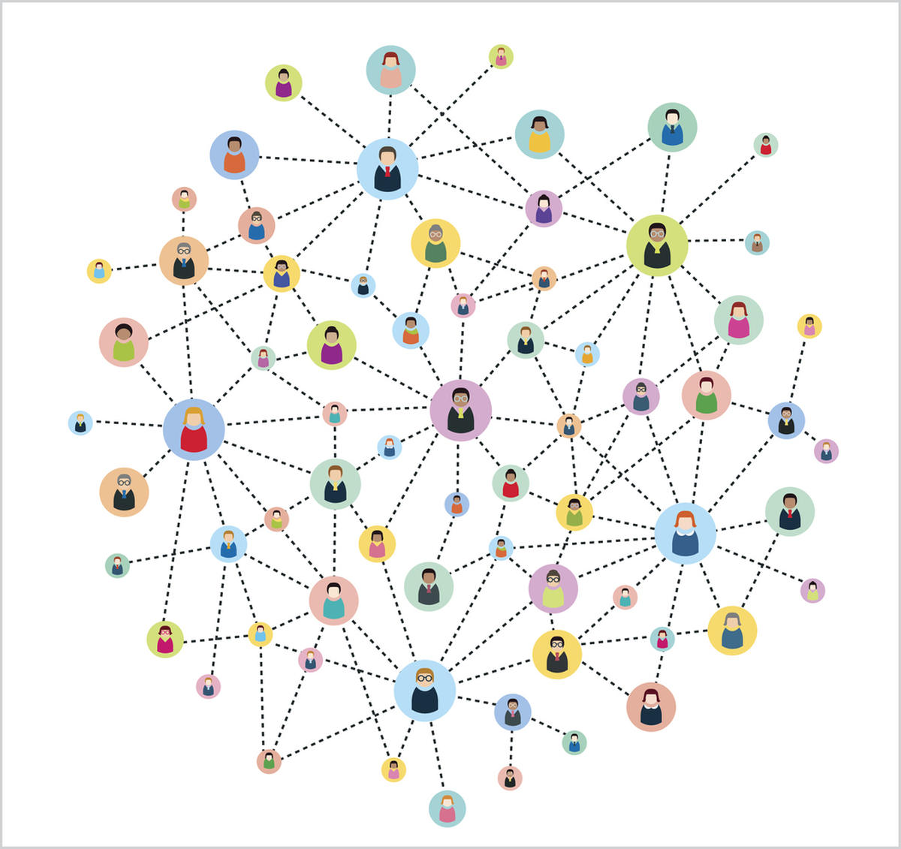
What is Text Analytics?
“A set of linguistic, statistical, and machine learning techniques that model and structure the information content of textual sources for business intelligence, exploratory data analysis, research, or investigation.”
Or, put more simply…
“Using technology to scale the human acts of reading, organizing, and quantifying unstructured text data in meaningful ways.”
Notes:
Structured data has been out there since the early 1900s but what made text mining and text analytics so special is that leveraging the information from unstructured data (Natural Language Processing). Once we are able to convert this unstructured text into semi-structured or structured data it will be available to apply all the data mining algorithms ex. Statistical and machine learning algorithms.
Even Donald Trump was able to leverage the data and convert it to information which helped him to win the US presidential elections, well basically he didn’t do it his subordinates did. There is a very good article out there http://fivethirtyeight.com/features/the-real-story-of-2016/ you can go through it.

Slide 6
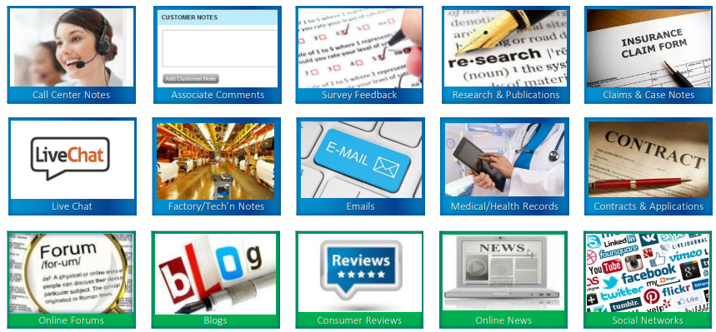
Common Textual Data Sources

Slide 7
Natural Language Processing (NLP)
NLP is the study of human language.
Most challenging problems for computers to understand natural languages as humans do.
NLP research pursues the vague question of how we understand the meaning of a sentence or a document. What are the indications we use to understand who did what to whom?
The role of NLP in text mining is to deliver the system in the information extraction phase as an input.

Slide 8
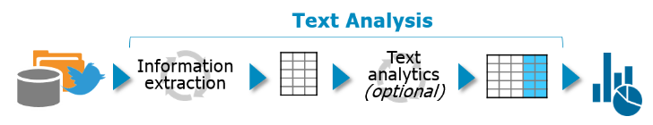
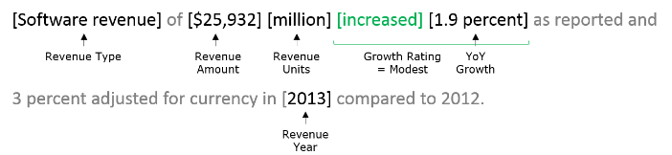
Information Extraction (IE)
Information Extraction is the task of automatically extracting structured information from unstructured. In most of the cases, this activity includes processing human language texts by means of NLP.
The first step when analyzing text is to recognize what’s useful and what’s not. The typical tasks are:
Detect terms based on data types, specific words and linguistic context
Classify and organize terms, often leveraging dictionaries or ontologies
Describe these terms, ranging from simple rating systems to complex statistical methods
Consider this sentence: “Software revenue of $25,932 million increased 1.9 percent as reported and 3 percent adjusted for currency in 2013 compared to 2012.”

Slide 9
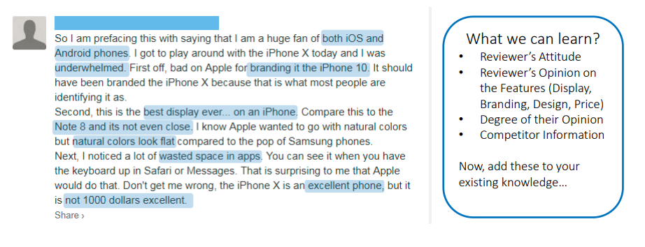
What Can We Learn From Text?

Slide 10
Text mining
Text Analytics
is basically cleaning up of data to be available for text analytics.
a tool that helps in getting the data cleaned up.
similar to ETL (Extract Transform Load), which means to be able to insert data into database these steps are carried out.
Python and R are the most famous text mining tools out there for text mining.
Examples:
text categorization
text clustering
concept/entity extraction
sentiment analysis
document summarization
production of granular taxonomies
Entity relation modeling
is applying of statistical and machine learning techniques to be able to predict /prescribe or infer any information from the text-mined data.
is the process of applying the algorithms.
this data is used to add values to the business, example creating word clouds, bi-grams frequency charts, N-grams in some cases.
python and R, including others e.g., Power BI, Azure, KNIME, etc.
Examples:
Association analysis
visualization
predictive analytics
information retrieval
lexical analysis
pattern recognition
tagging/annotation
Meaning
Concept
Framework
Language

Slide 11
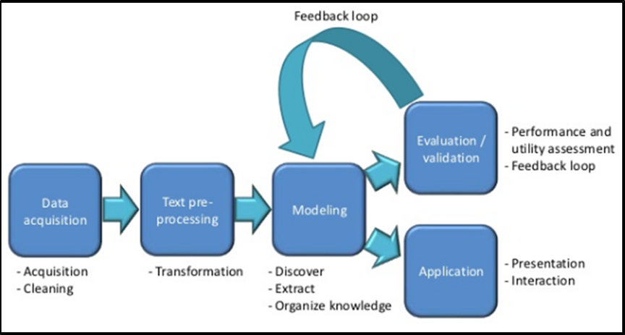
Typical Text Mining Process

Slide 12
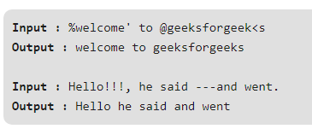
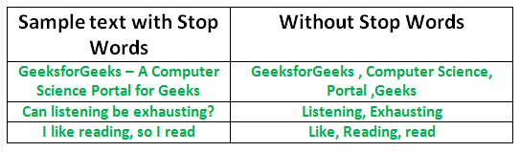
Text Pre-processing
Tokenization — the process of tokenizing or splitting a string, text into a list of tokens. (e.g. convert sentences to words)
text = "Hello everyone. Welcome to GeeksforGeeks.“
Removing unnecessary punctuation, tags
Removing stop words — frequent words such as, ”the”, ”is”, etc. that do not have specific semantic.

Slide 13
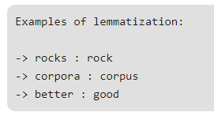
Stemming — words are reduced to a root by removing inflection through dropping unnecessary characters, usually a suffix.
A stemming algorithm reduces the words “chocolates”, “chocolatey”, “choco” to the root word, “chocolate” and “retrieval”, “retrieved”, “retrieves” reduce to the stem “retrieve”.
Lemmatization — another approach to remove inflection by determining the part of speech and utilizing detailed database of the language. Lemmatization does morphological analysis of the words.

Slide 14
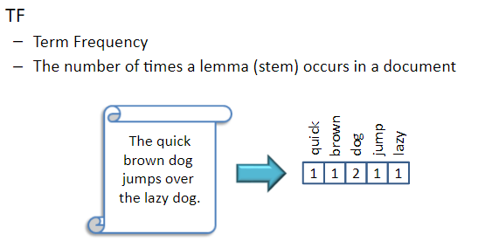
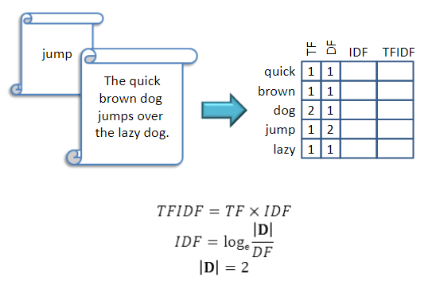
Term frequency – Inverse Document Frequency (TF-IDF) is a numerical statistic that is intended to reflect how important a word is to a document in a collection or corpus.

Slide 15
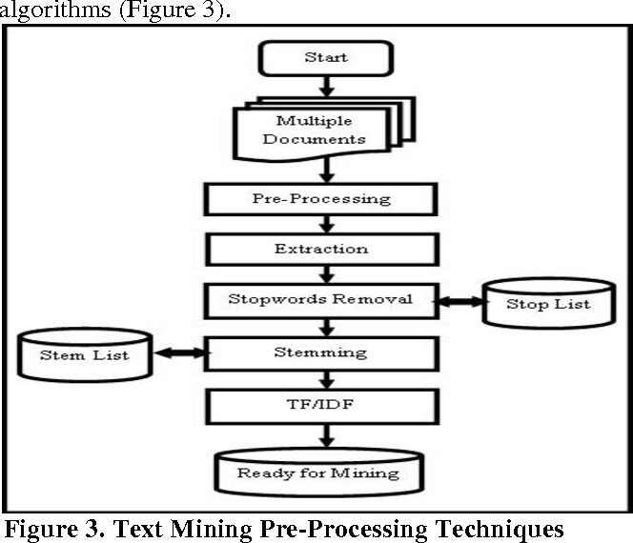

Slide 16
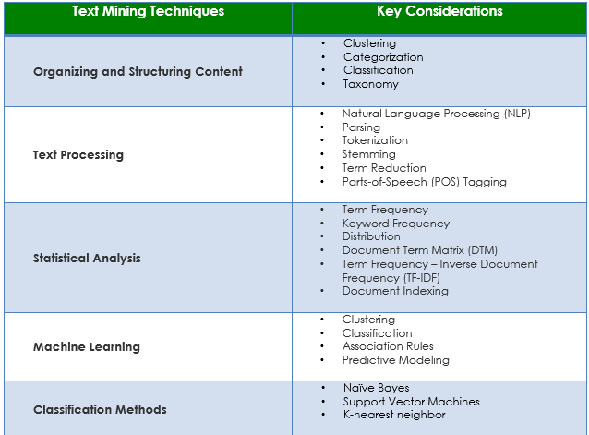
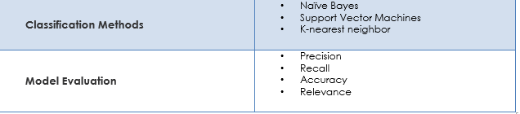

Slide 17
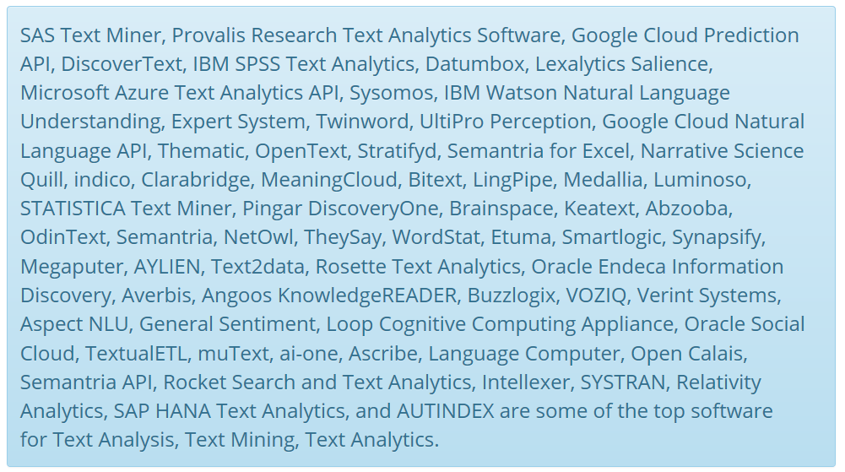
Text Analytics Software Solutions
Tools, servers, analytic algorithm based applications, data mining and extraction tools for converting unstructured data into meaningful data for analysis.
Top Text Analytics Software

Slide 18
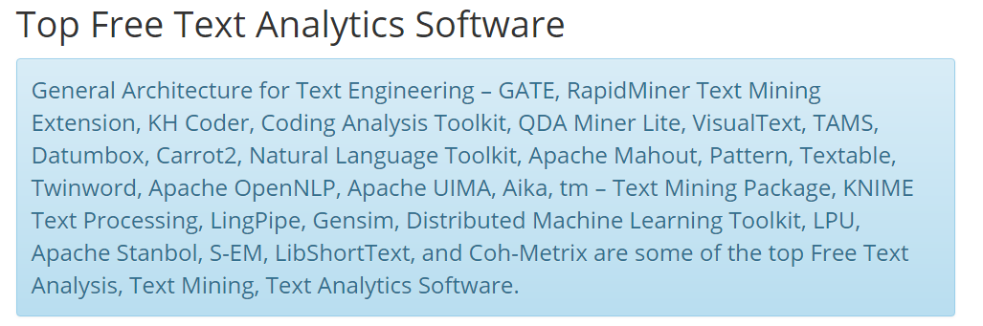

Slide 19
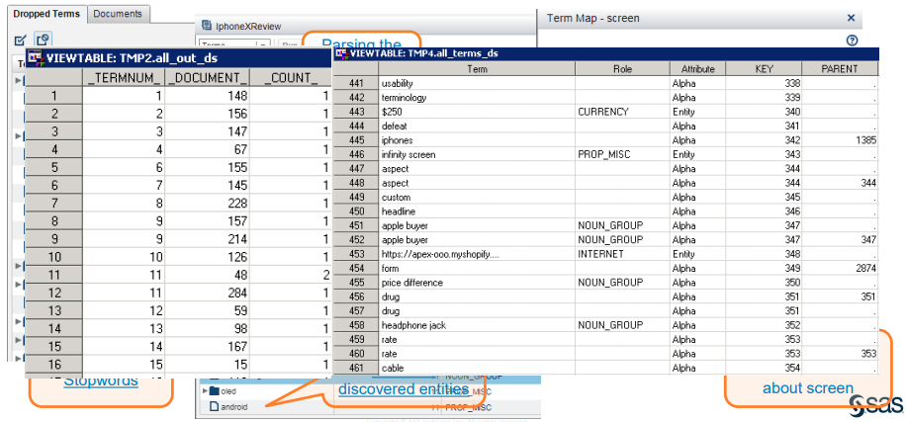
Text Preprocessing Structuring the Unstructured

Slide 20
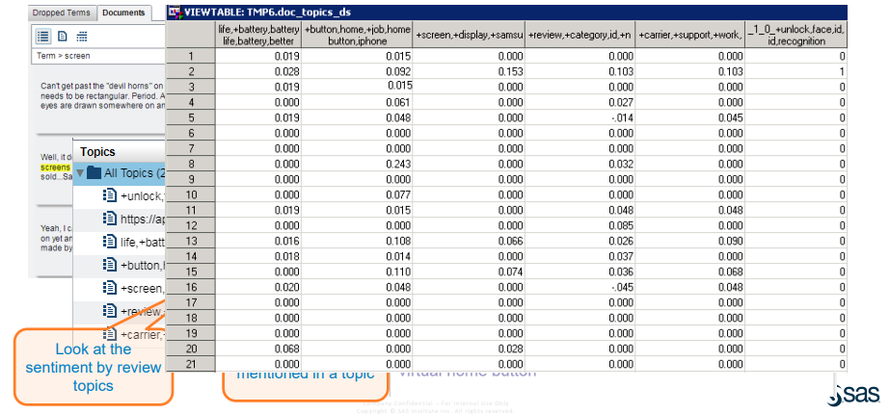
Exploratory Analysis on Text Unsupervised Learning

Slide 21
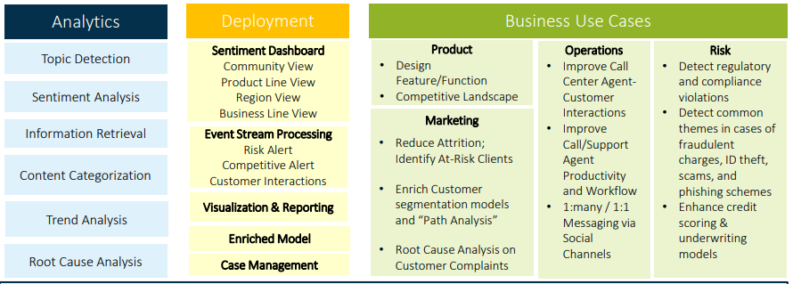
What Are Others Using Text Analytics For?

Slide 22
What You Want To Look For? Fully Customizable, Balanced Approach to Text Analytics Problem
In order to gain business value from unstructured text, we need:
Structured + Unstructured
• To gain the lift in predictive accuracy from text
Supervised + Unsupervised
• To shorten the Time to Value, minimizing the manual effort while maintaining granularity and specificity
Linguistic Rules + Statistical Model
• To get desired level of granularity and customization ability

Slide 23

What Makes Text Analytics Hard? And Interesting …
Problem Specific
Domain Specific
Out-Of-Box tool does not work
Ability to customize is critical
Human Subjectivity
Same message conveyed in different ways
Exactly the same statement in a different context may convey completely different meaning.
Language & Cultural Specific
Requires deep knowledge about the language and the culture
Social media as a new source of data
Same meaning, different words: Australians, Britons and Americans use the terms “daks,” “trousers” and “pants” respectively to refer to the same piece of clothing.

Slide 24
Sentiment Analysis
Aka opinion mining, opinion extraction, subjectivity analysis.
Detection of attitude towards objects / person.
Study sentiment (internal or external) expressed in text.
Usage or applications:
Individual – make decision (e.g. on products)
Business – benchmark products / services (market intelligence)
Product rating
Politics
Public sentiment
Opinion retrieval – provide general search for opinions.
Opinions from many people → opinion summarization → decision → action
See Twitter Sentiment App (www.sentiment140.com)

Slide 25
Two Types of Opinions
Regular opinions: Sentiment/opinion expressions on some target entities
Direct opinions:
“The touch screen is really cool.”
Indirect opinions:
“After taking the drug, my pain has gone.”
Comparative opinions: Comparison of more than one entity.
E.g., “iPhone is better than Blackberry.”
We focus on regular opinions first, and just call them opinions.

Slide 26
4 Basic Components of Opinion
An opinion is a quadruple (Liu, 2012),
(target, sentiment, holder, time)
Opinion targets (document, sentence, aspect/feature)
Sentiments (positive, negative, neutral)
Opinion holders / source (the person who hold the opinions)
Time when opinions are expressed

Slide 27
Can Text Analytics Identify Sarcasm?
Analysis is for positive-negative sentiment rather than mood detection.
There is always some degree of imprecision in sentiment analysis, but the model is most useful when there is no hidden meaning or subtext to the content. Irony, sarcasm, humor, and similarly nuanced content rely on cultural context and norms to convey intent.
This type of content is among the most challenging to analyze. Typically, the greatest discrepancy between a given score produced by the analyzer and a subjective assessment by a human is for content with nuanced meaning.

Slide 28
References
Text Analytics in Action (Toronto Data Sciences Forum) by Cindy Zhong, Data Scientist, SAS Canada
https://www.sas.com/content/dam/SAS/en_ca/User%20Group%20Presentations/Toronto-Data-Mining-Forum/zhong_text_analytics.pdf
What is Text Analytics? https://www.predictiveanalyticstoday.com/text-analytics/#content-anchor
Why is analyzing text so hard? https://www.ibmbigdatahub.com/blog/why-analyzing-text-so-hard

